Slide 1






Hello Tomorrow

Slide 2
Emirates Ab initio Programme. Tomorrow’s Cabin Crew
Notes:
Significant investment and changes had been made to the onboard economy product
The current Ab initio Service Training course is a 12 day programme originally developed in 2008 - 6 years since a systematic review of the Cabin Crew Service Training Ab initio programme.
the course is regularly updated to keep in line with current changes and integration of Safety and Emergency Procedures [SEP] scenarios took place in 2012 to enhance the realism of the training to experiences on line.
enhance learner participation and more effectively integrate training strategies with online practice.

Slide 3
Journey…
Feedback
Research
Findings
Design
Implementation

Slide 4
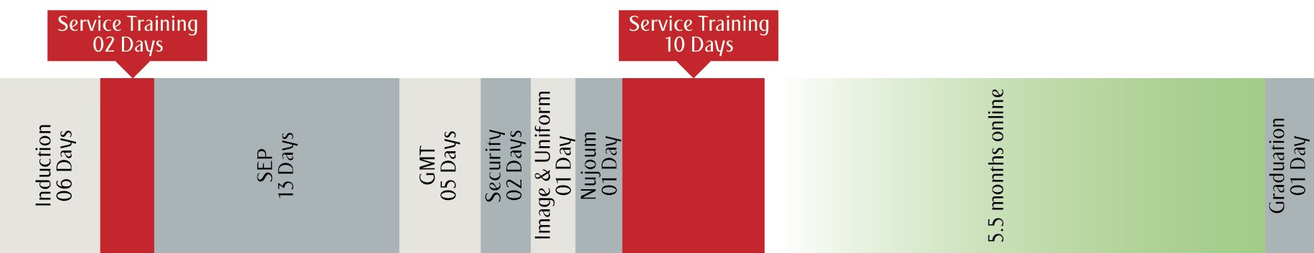
Footprint: 2008 - 2015
Ab initio Service Training course duration: 12 days

Slide 5
Cabin Crew Growth
Service Training Footprint

Slide 6
Research: quantitative / qualitative
Internal Customer Feedback
External Customer Feedback
Industry
Course Evaluation
Learner/onboard crew performance
Questionnaires
Focus Groups
Customer Affairs & Service Audit
Market Research:
Inflight Survey Airs@t
Skytrax
Competitor and other airline benchmarks Hospitality and Customer Service industries

Slide 7
Research: findings
Internal Customer Feedback
External Customer Feedback
Internal Stakeholder
Feedback
Customer scenarios & problem solving techniques
Practical sessions
Service skills
Duty Free
Galley management
Explore the use of technology
Interpersonal skills
Attentiveness
Product knowledge
Cabin presence
Increase the time spent on Hospitality & Customer Care
Implement an Assessment in addition to Refresher training at the end of the probation period

Slide 8
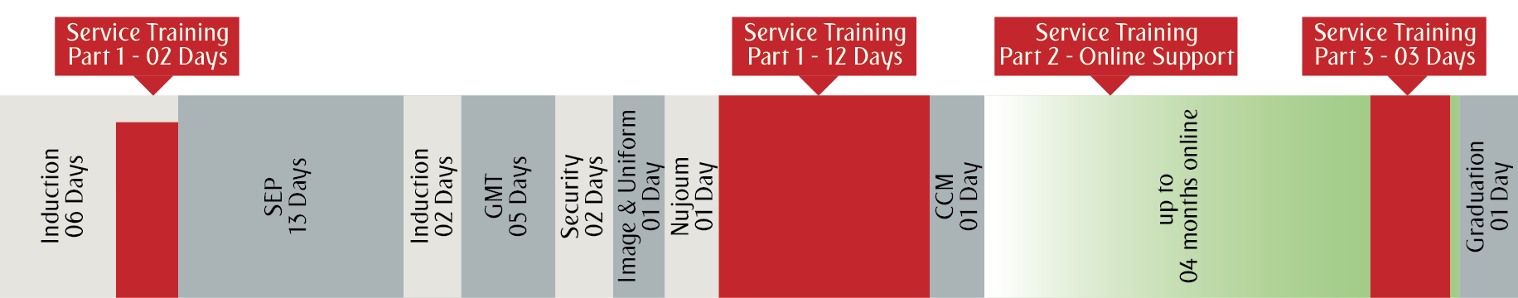
Footprint: May 2015
Service Training components split into 3 Parts
Part 1
Part 2
Part 3
Extended by 2 days
Introduced on job learning with online support
Implemented Assessment & Refresher course – 3 days

Slide 9
Interesting facts…
New Ab initio Service Training course launched on 3rd May 2015 – 13th Nov 2016
Number of Courses
Number of Learners
517
7519

Slide 10
Interesting facts…
3 Day - Service Assessment & Refresher course[YSA] launched on 19th Oct 2015 – 16th Nov 2016
Number of Courses
Number of Learners
332
6098

Slide 11
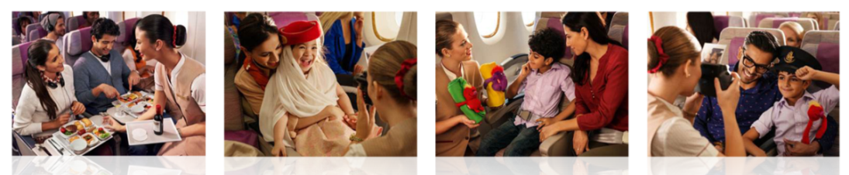

Course enhancements:
Hospitality & Customer Care session time doubled
Focus on customer service skills: positive interaction with customers and problem solving

Slide 12
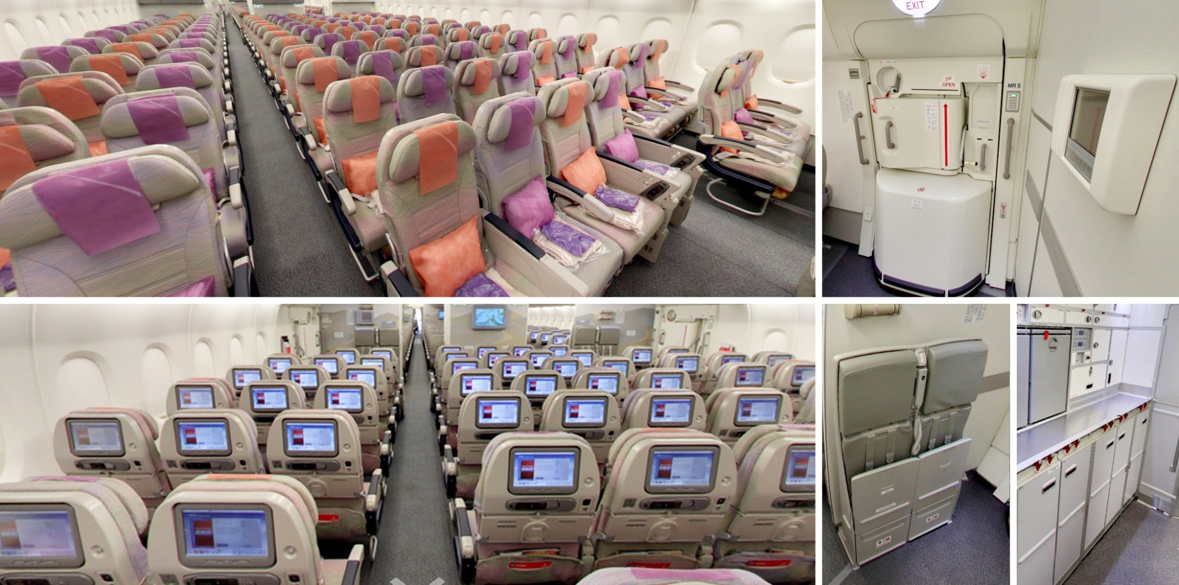
Course enhancements:
Simulate - realistic boarding and flight experience - Doha

Slide 13

Course enhancements:
Wider use of multi-media to enhance learning and retain knowledge

Slide 14

Course enhancements:
Introduced: On job learning with online support
Probationary Crew – produce a learning portfolio
Online Support Team
Workshops
Reviews
Webinars
Support sessions
Email Support : probationarycrew@emirates.com
Portal Support : Career & Development > Learning Hub > Economy Class

Slide 15
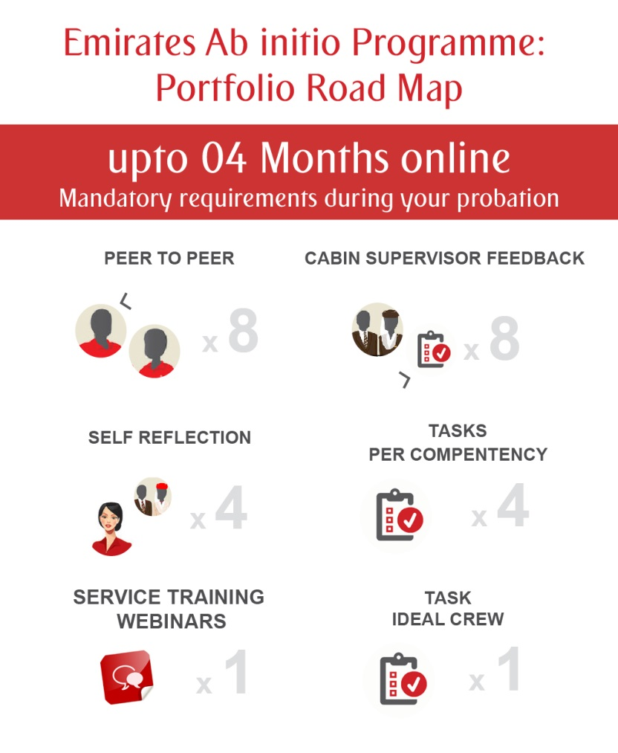
Notes:
Provide support to the probationary crew on how and when to complete the portfolio.

Slide 16
Interesting facts…
Online Support – Service Training launched on Aug/Sep 2015 – Nov 2016
Number of Workshops
Number of Learners attendance
65
4511
Number of Webinars
Number of Learners registered
36
7303

Slide 17
Course enhancements:
Implemented a variety of assessment methods i.e. peer to peer feedback
Duty Free operator training moved from part 1 to part 3 to support initial transfer of learning to online
Enhanced the training matrix to identify and categorise learner’s performance
Notes:
i.e. ability to recognise high performers and crew with development requirements

Slide 18
Performance matrix
Above100.01
Service Stars - Achieving & Contributing with Impact
100.00 90.01
Achieving
Key/Scale
90.01 80.01
Working Towards
80.00 70.01
Unsatisfactory
70.00
Below
Below Standard

Slide 19
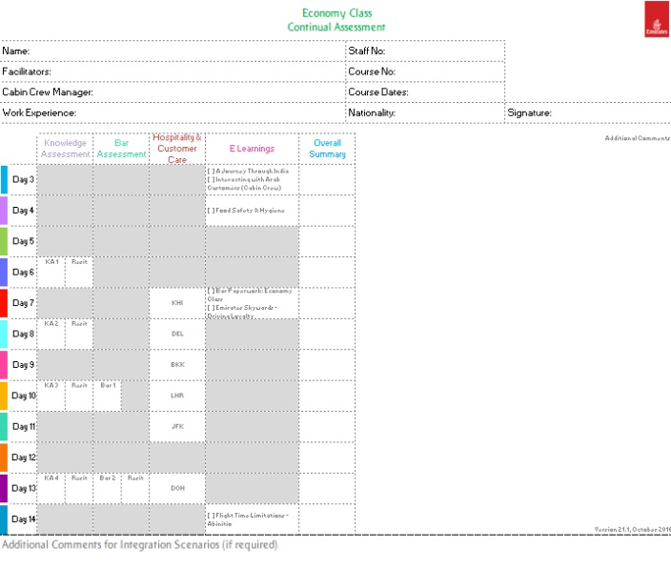
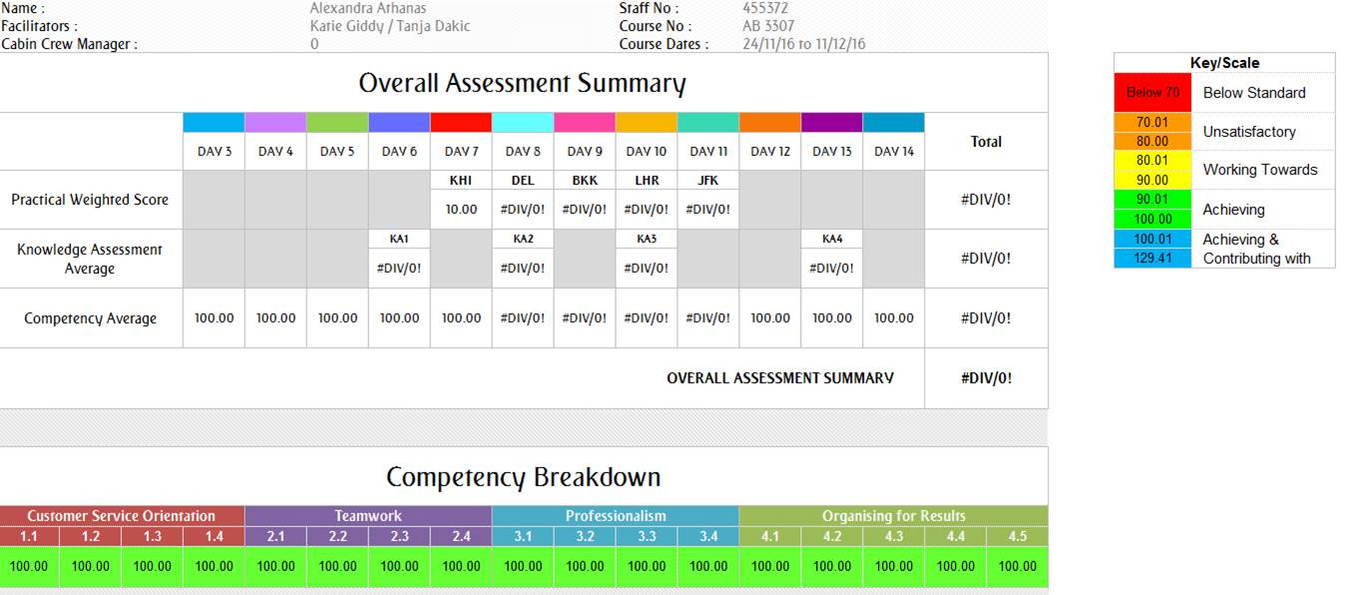
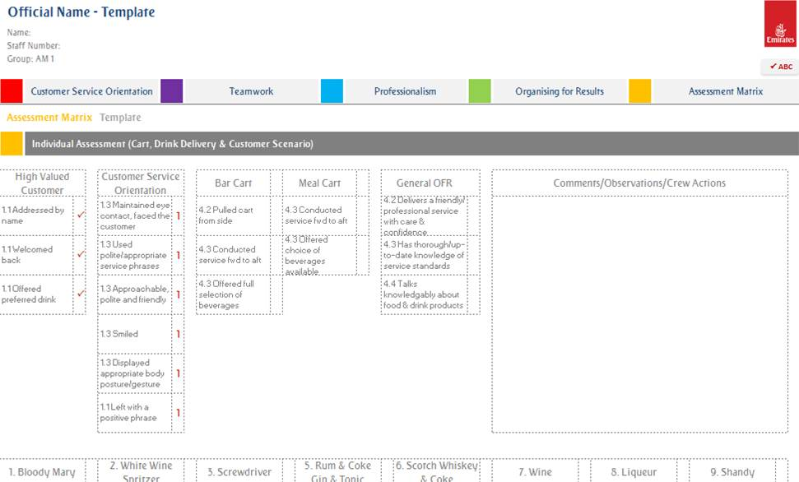
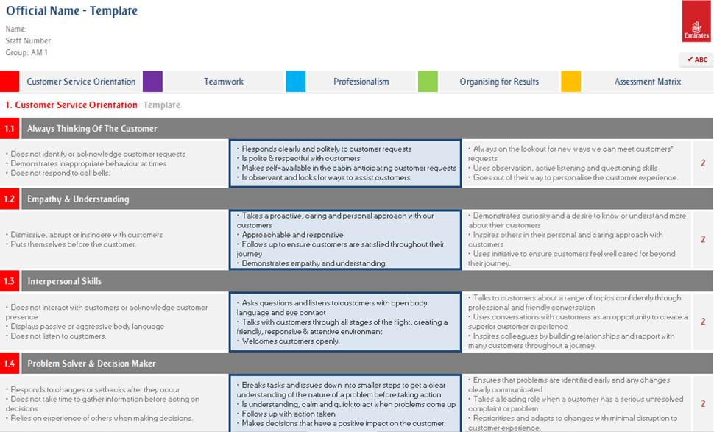
Performance matrix

Slide 20
High performers - Service Stars…
Out of 7519 learners
Total number of Learners
Scored above 100.01 %

Slide 21
Course enhancements:
Implemented a variety of assessment methods i.e. peer to peer feedback
Duty Free operator training moved from part 1 to part 3 to support initial transfer of learning to online
Enhanced the training matrix to identify and categorise learner’s performance
Designed a Service Review day for additional support
Notes:
i.e. ability to recognise high performers and crew with development requirements

Slide 22
Impact of Service Reviews…
Out of 7519 learners, 136 learners flagged for Service Review
Total number of Learners
Results of Service Review

Slide 23
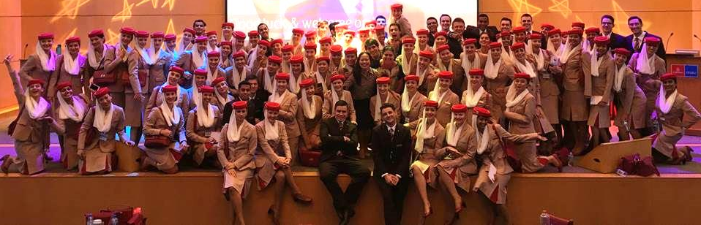

Course enhancements
Enhanced active collaboration between CC Management and CC Training teams
Welcome On Board day
Performance Management

Slide 24
Implementation - cost per course
3 Day - Service Assessment & Refresher course[YSA]
Operational - manpower 20 learners & 2 Trainers
AED 29,640

Slide 25
Media Launch

Slide 26

Tomorrow’s Cabin Crew

Slide 27
Customer Feedback

Slide 28




Internal Customer Feedback: Course evaluation learner’s comments…
Good structured course, just the right amount of home studies. They helped me prepare for the sessions.
The training period went over my expectations. I feel confident and totally able to operate the flights.
Very happy to participate in this training. Everything related in service training course was clear and very helpful for me. Thank you very much.
Course was fully executed by our amazing trainers.
Service training was extremely interesting and knowledgeable
for me.

Slide 29
Internal Customer Feedback: On board Cabin Supervisor’s comments…
The new crew are full of energy and keen to engage with customers.
The new crew are eager to operate the galley.
The performance of the grade 2 crew members have significantly improved. Crew members are more confident, efficient and proactive.
The probationary crew appear to be more solution focussed and feel confident dealing with customer’s situations.

Slide 30
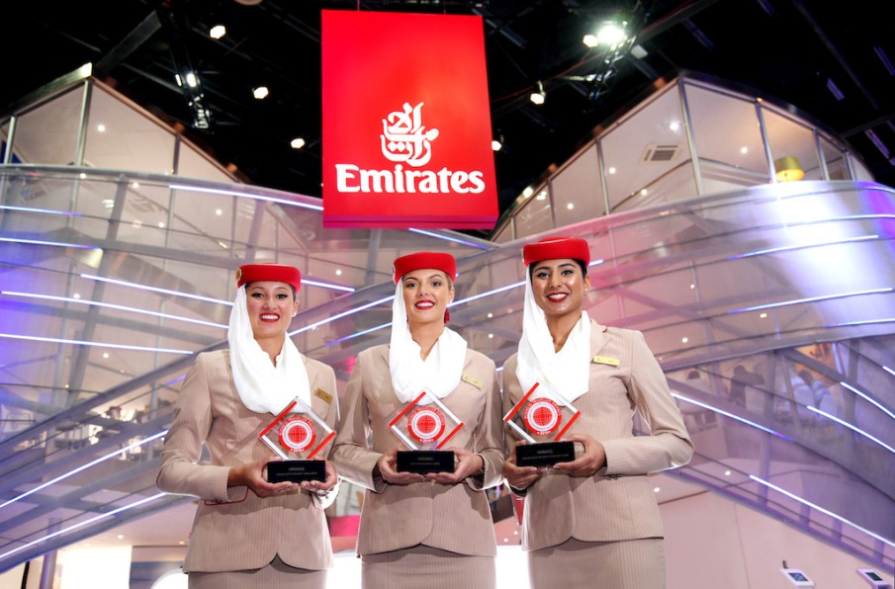
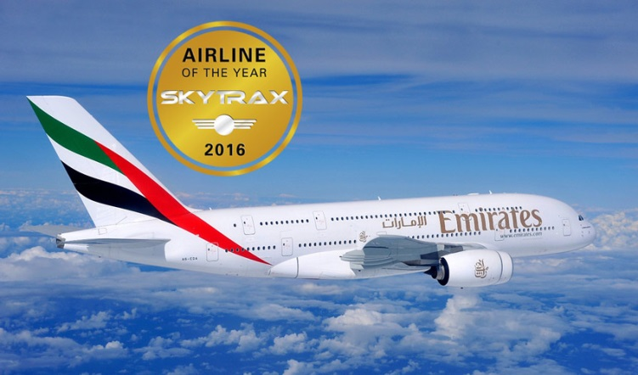
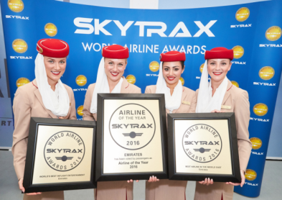
External Customer Feedback:
Best Economy Class & Airline with the Best Cabin Staff
Business Traveller Awards April 2016
World’s Best Airline
Skytrax World Airline Awards July 2016

Slide 31
Ongoing & future focus…
Continue to review the course curriculum – efficiencies/costs
Talent management – cabin crew community
Continuous improvement – Business & First Class Upgrade courses
IT platforms for data management
Enhanced integration and implementation of technology - potentially reduce the footfall in the college

Slide 32
Thank
You

